Slide 1
Cost theory

Slide 2
The Meaning of Costs
Opportunity costs
  meaning of opportunity cost
  examples
Measuring a firm’s opportunity costs
  factors not owned by the firm: explicit costs
  factors already owned by the firm: implicit costs

Slide 3
Costs
Short run – Diminishing marginal returns results from adding successive quantities of variable factors to a fixed factor
Long run – Increases in capacity can lead to increasing, decreasing or constant returns to scale

Slide 4
Costs
In buying factor inputs, the firm
will incur costs
Costs are classified as:
  Fixed costs – costs that are not related directly to production – rent, rates, insurance costs, admin costs. They can change but not in relation to output
  Variable Costs – costs directly related
  to variations in output. Raw materials, labour, fuel, etc

Slide 5
Costs
Total Cost - the sum of all costs incurred in production
TC = FC + VC
Average Cost – the cost per unit
of output
AC = TC/Output
Marginal Cost – the cost of one more or one fewer units of production
MC = TC_{n} – TC_{n-1} units

Slide 6
Marginal Product and Costs
Suppose a firm pays each worker $50 a day.
Units of Labor | Total Product | MP | VC | MC
0 | 0 | 10 | 0 | 5
1 | 10 | 15 | 50 | 3.33
2 | 25 | 20 | 100 | 2.5
3 | 45 | 15 | 150 | 3.33
4 | 60 | 10 | 200 | 5
5 | 70 | 5 | 250 | 10
6 | 75 |  | 300

Slide 7
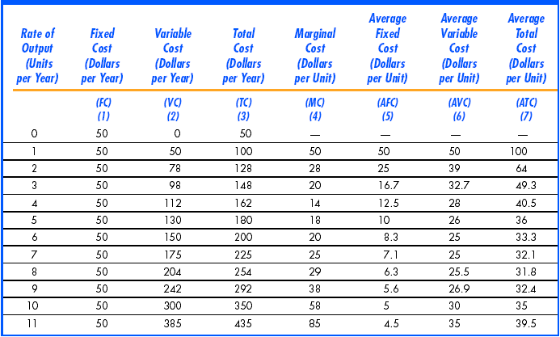
A Firm’s Short Run Costs

Slide 8
Average Costs
Average Total cost – firm’s total cost divided by its level of output (average cost per unit of output)
ATC=AC=TC/Q
Average Fixed cost – fixed cost divided by level of output (fixed cost per unit of output)
AFC=FC/Q
Average variable cost – variable cost divided by the level of output.
    AVC=VC/Q

Slide 9
Marginal Cost – change (increase) in cost resulting from the production of one extra unit of output
Denote “∆” - change. For example ∆TC - change in total cost
MC=∆TC/∆Q
Example: when 4 units of output are produced, the cost is 80, when 5 units are produced, the cost is 90. MC=(90-80)/1=10
MC=∆VC/∆Q
since TC=(FC+VC) and FC does not change with Q

Slide 10
Cost Curves for a Firm
TC
Cost
($ per
year)
400
Total cost
is the vertical
sum of FC
and VC.
VC
300
Variable cost
increases with
production and
the rate varies with
increasing &
decreasing returns.
200
100
Fixed cost does not
vary with output
50
FC
0
1
2
3
4
5
6
7
8
9
10
11
12
13
Output
Notes:
33

Slide 11
Average total cost curve (ATC)
The average fixed cost curve is a rectangular hyperbola as the curve becomes asymptotes
to the axes.
The average variable cost is a mirror image of the average product curve .
The average total cost curve is the sum of AFC and the AVC.

Slide 12
When both the curves are falling, the ATC which is the sum of both is also falling.
When AVC starts to rise, the average fixed cost curve falls faster and hence the sum falls. Beyond a point, the rise in AVC is more than the fall in AFC and their sum rises.
Hence the ATC is an U shaped curve

Slide 13
AVC = W.L/Q
= W/AP
= W. 1/AP
Hence AP and AVC are inversely related.
Thus AVC is an inverted U shaped curve
MC = Change in TC = d (WL)/dQ
= WdL/dQ
= W(1/MP)
Hence The Marginal cost is the inverse of the MP curve.

Slide 14
Short-run Costs and Marginal Product
production with one input L – labor; (capital is fixed)
Assume the wage rate (w) is fixed
Variable costs is the per unit cost of extra labor times the amount of extra labor: VC=wL
Denote “∆” - change. For example ∆VC is change in variable cost.
MC=∆VC/∆Q ; MC =w/MP_{L},
where MP_{L}=∆Q/∆L
With diminishing marginal returns: marginal cost increases as output increases.
Notes:
18

Slide 15

Average and marginal costs
MC
Diminishing marginal
returns set in here
Costs (£)
x
Output (Q)

Slide 16
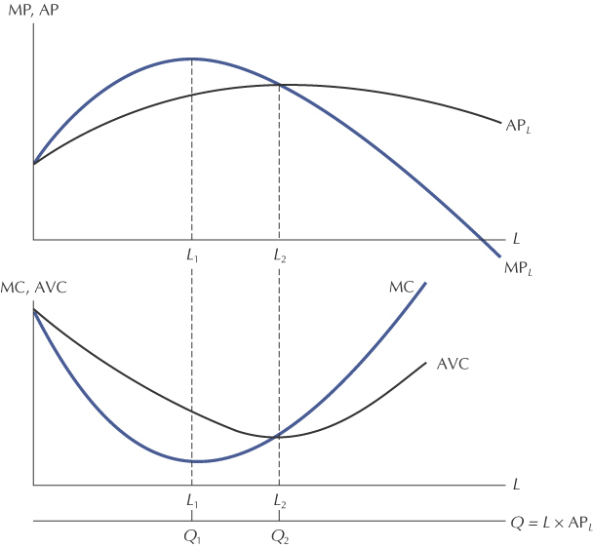
The Relationship Between MP, AP, MC, and AVC

Slide 17
Average and marginal costs
MC
AC
AVC
Costs (£)
z
y
x
AFC
Output (Q)

Slide 18
Shift of the curves
TC’
TC
Cost
($ per
year)
400
VC
300
200
150
FC’
100
50
FC
0
1
2
3
4
5
6
7
8
9
10
11
12
13
Output
Notes:
33

Slide 19
Summary
In the short run, the total cost of any level of output is the sum of fixed
and variable costs: TC=FC+VC
Average fixed (AFC), average variable (AVC), and average total costs
(ATC) are fixed, variable, and total costs per unit of output; marginal
cost is the extra cost of producing 1 more unit of output.
AFC is decreasing
AVC and ATC are U-shaped, reflecting increasing and then diminishing
returns.
Marginal cost curve (MC) falls and then rises, intersecting both AVC
and ATC at their minimum points.

Slide 20
The Envelope Relationship
In the long run all inputs are flexible, while in the short run some inputs are not flexible.
As a result, long-run cost will always be less than or equal to short-run cost.

Slide 21
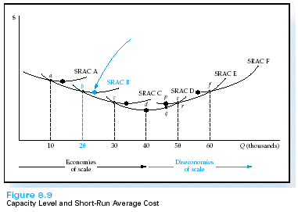
The Long-Run Cost Function
The LRAC is the lower envelope of all of the SRAC curves.
LRAC is made up for SRACs
  SRAC curves represent various plant sizes
  Once a plant size is chosen, per-unit production costs are found by moving along that particular SRAC curve

Slide 22
The Envelope Relationship
The envelope relationship explains that:
  At the planned output level, short-run average total cost equals long-run average total cost.
  At all other levels of output, short-run average total cost is higher than long-run average total cost.

Slide 23
Deriving long-run average cost curves: factories of fixed size
SRAC₁
SRAC₅
SRAC₂
SRAC₃
SRAC₄
1 factory
5 factories
Costs
2 factories
4 factories
3 factories
O
Output

Slide 24
Deriving long-run average cost curves: factories of fixed size
SRAC₁
SRAC₅
SRAC₂
SRAC₃
SRAC₄
LRAC
Costs
O
Output

Slide 25
Envelope of Short-Run Average Total Cost Curves
LRATC
SRATC₄
SRATC₁
SRMC₁
Costs per unit
SRMC₂
SRATC₂
SRMC₄
SRATC₃
SRMC₃
0
Q₂
Q₃
Quantity

Slide 26
Envelope of Short-Run Average Total Cost Curves
LRATC
SRATC₄
SRATC₁
SRMC₁
Costs per unit
SRMC₂
SRATC₂
SRMC₄
SRATC₃
SRMC₃
0
Q₂
Q₃
Quantity

Slide 27
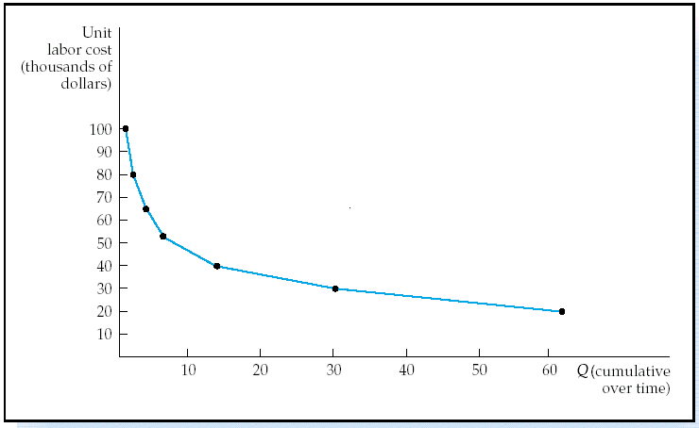
The Learning Curve
Measures the percentage decrease in additional labor cost each time output doubles.
  An “80 percent” learning curve implies that the labor costs associated with the incremental output will decrease to 80% of their previous level.

Slide 28
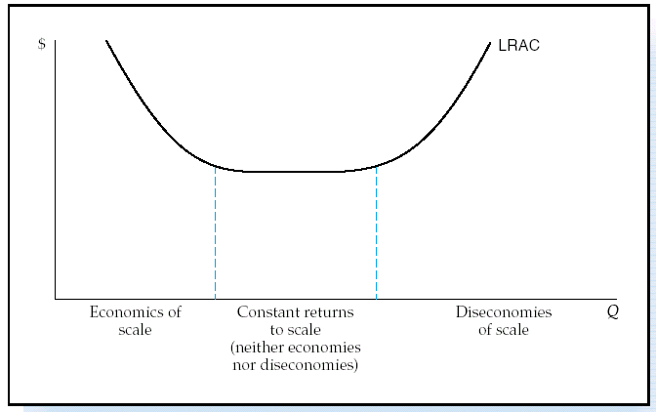
The LR Relationship Between
Production and Cost
In the long run, all inputs are variable.
  What makes up LRAC?

Slide 29
Production in the Long run
Economies of scale
  specialisation & division of labour
  indivisibilities
  container principle
  greater efficiency of large machines
  by-products
  multi-stage production
  organisational & administrative economies
  financial economies
Notes:
5

Slide 30
Production in the Long run
Diseconomies of scale
  managerial diseconomies
  effects of workers and industrial relations
  risks of interdependencies
External economies of scale
Location
  balancing the distance from suppliers and consumers
  importance of transport costs
  Ancillary industries-by products
Notes:
6

Slide 31
Internal economies and diseconomies
affect the shape of the LAC
External Economies affect the position of the LAC
External Diseconomies may cause increase in prices of the factors of production

Slide 32
Economies of Scope
There are economies of scope when the costs of producing goods are interdependent so that it is less costly for a firm to produce one good when it is already producing another.
S = TC(Q_{A})+TC(Q_{B} )- TC(Q_{A} Q_{B})
TC(Q _{A},Q_{B} )

Slide 33
Economies of Scope
Firms look for both economies of scope and economies of scale.
Economies of scope play an important role in firms’ decisions of what combination of goods to produce.

Slide 34
Summary
An economically efficient production process must be technically efficient, but a technically efficient process may not be economically efficient.
The long-run average total cost curve is U-shaped because economies of scale cause average total cost to decrease; diseconomies of scale eventually cause average total cost to increase.

Slide 35
Summary
Marginal cost and short-run average cost curves slope upward because of diminishing marginal productivity.
The long-run average cost curve slopes upward because of diseconomies of scale.
The envelope relationship between short-run and long-run average cost curves shows that the short-run average cost curves are always above the long-run average cost curve.

Slide 36
Summary
Marginal cost and short-run average cost curves slope upward because of diminishing marginal productivity.
The long-run average cost curve slopes upward because of diseconomies of scale.
The envelope relationship between short-run and long-run average cost curves shows that the short-run average cost curves are always above the long-run average cost curve.

Slide 37
Summary
Marginal cost and short-run average cost curves slope upward because of diminishing marginal productivity.
The long-run average cost curve slopes upward because of diseconomies of scale.
The envelope relationship between short-run and long-run average cost curves shows that the short-run average cost curves are always above the long-run average cost curve.

Slide 38
Revenue
Total revenue – the total amount received from selling a given output
TR = P x Q
Average Revenue – the average amount received from selling each unit
AR = TR / Q
Marginal revenue – the amount received from selling one extra unit
of output
MR = TR_{n} – TR _{n-1} units

